Slide 1


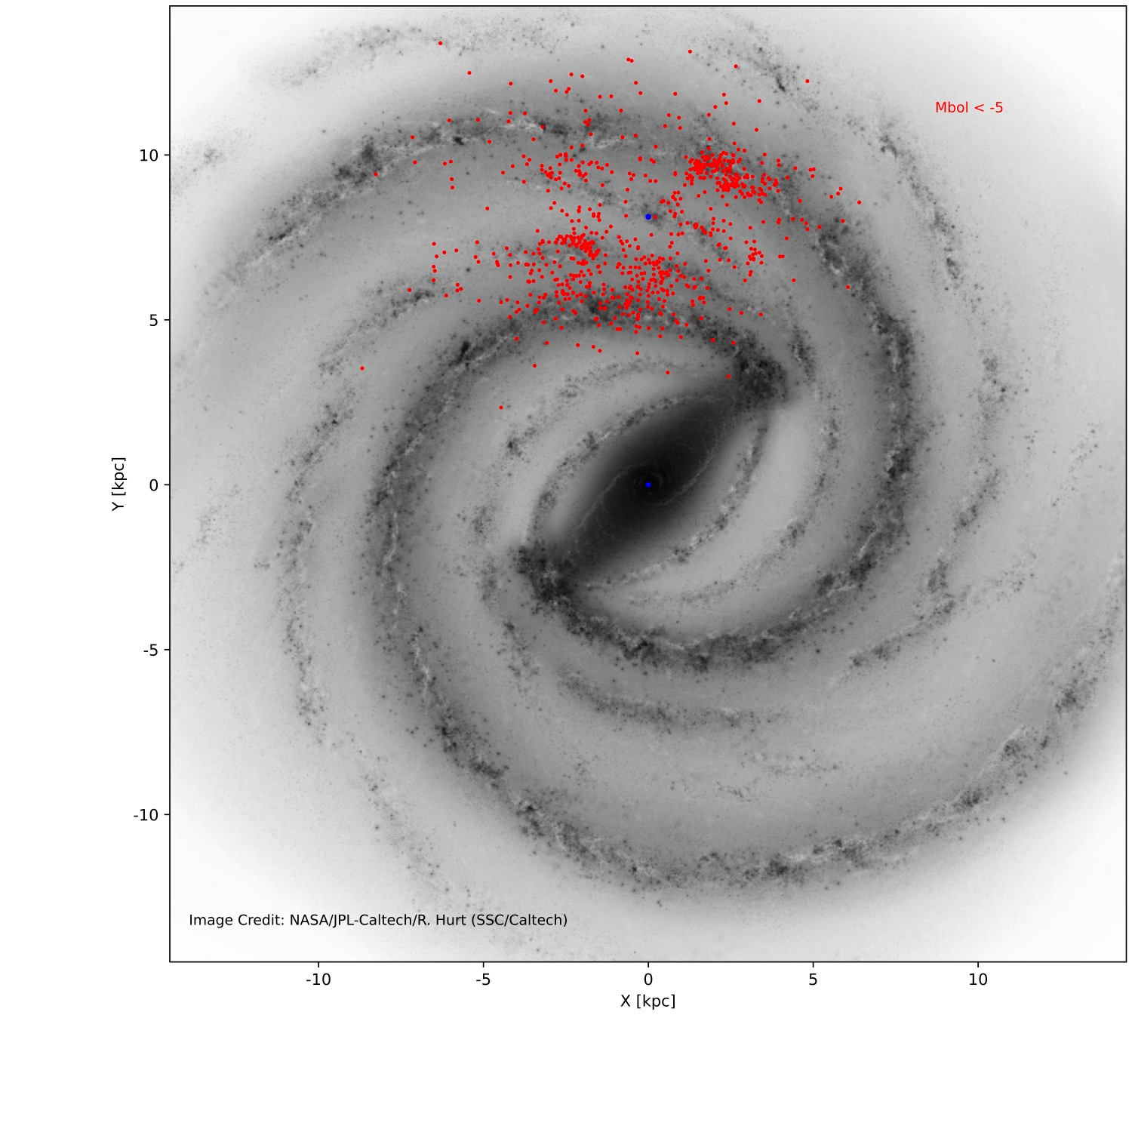


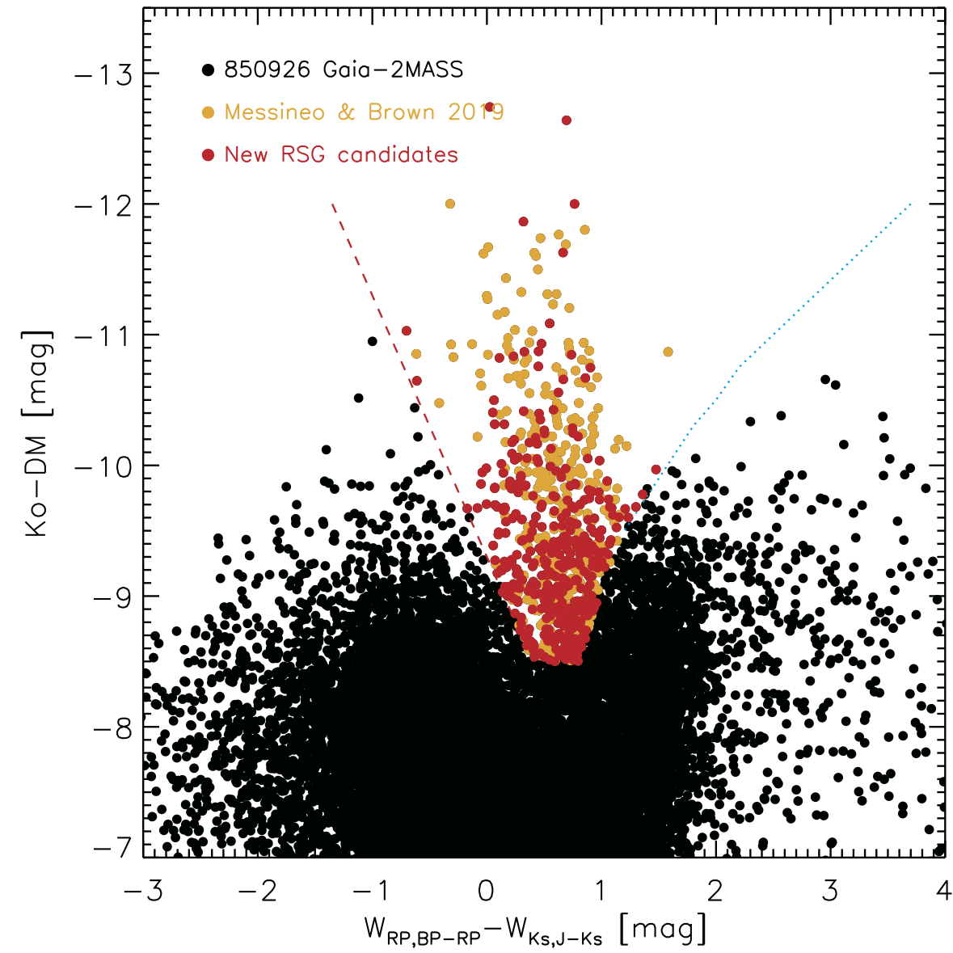
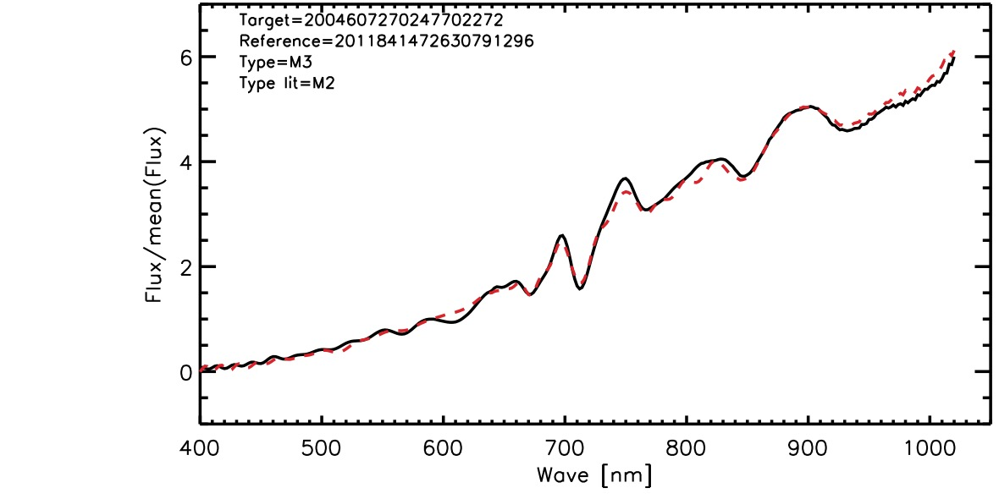
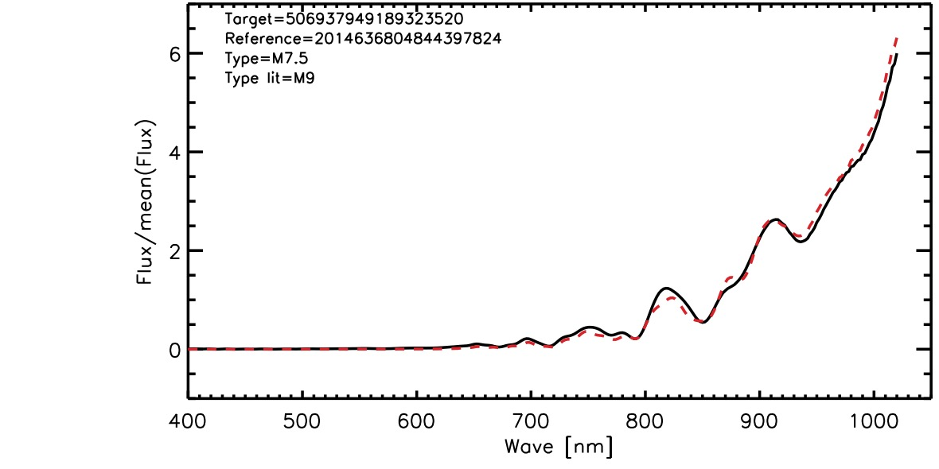
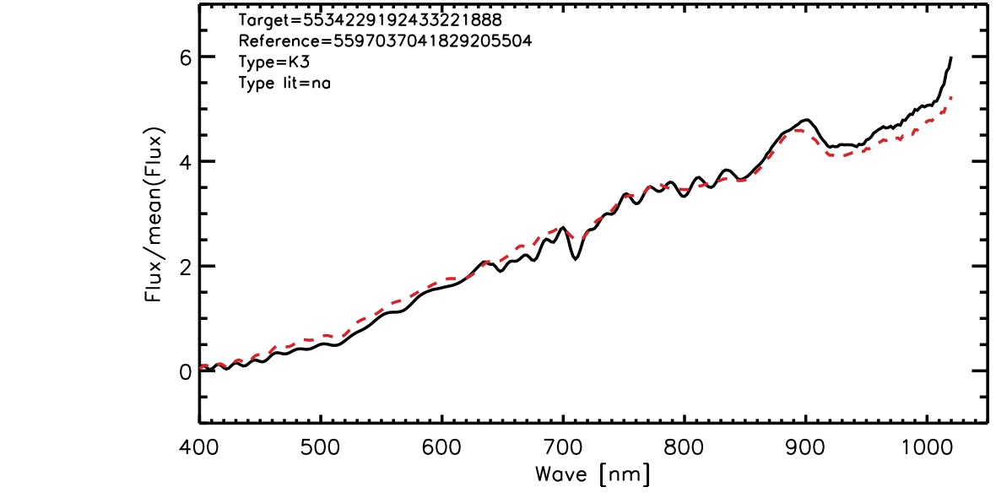
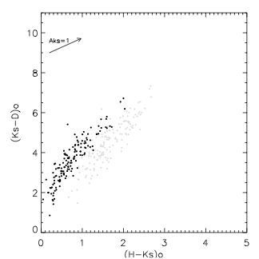
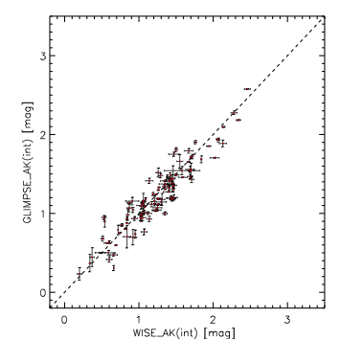
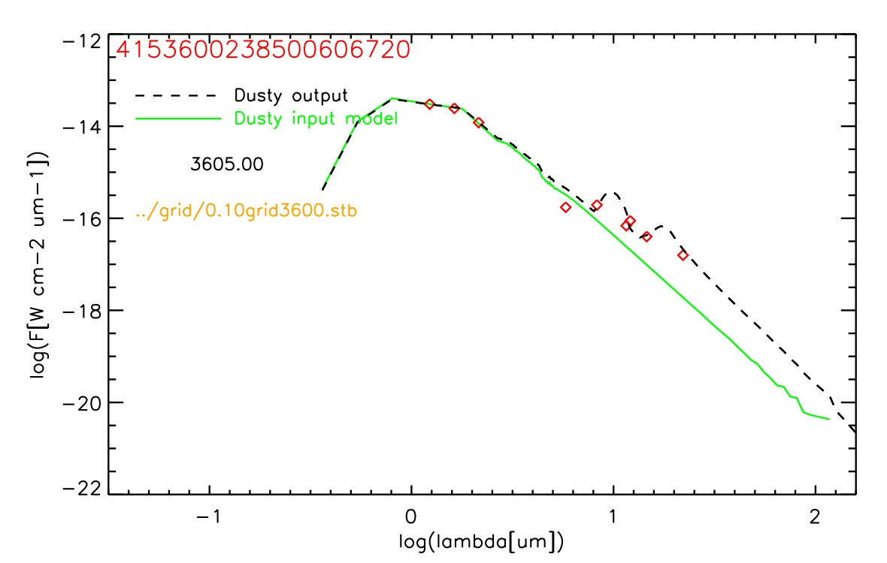
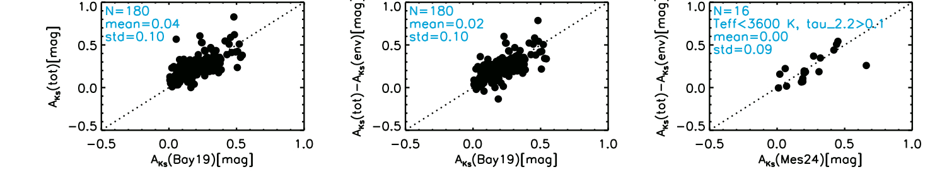
Extinction-Free Colours of Late-Type Stars in the Inner Galaxy
2024 A&A,686,222
2025, A&A, Forthcoming
Maria Messineo
(affiliated with Univ.Bologna-DIFA & INAF-OAS)
Infrared maps of the Milky Way are dominated by luminous late-type stars. Among those with Mbol​<−5 mag, two populations are identified: red supergiants (RSGs) and asymptotic giant branch stars (AGBs). RSGs are cool stars with temperatures​ below 4500 K and ages between ~4.5 and 30–40 Myr, while AGBs span a much broader age range, from ~50 Myr to the Hubble time. Although RSGs and AGBs exhibit similar spectral energy distributions and apparent magnitudes, their spatial distributions across the Galaxy differ significantly. As in external spiral galaxies, AGBs are tracers of the Galactic potential with its central bar (Habing et al. 2006). In contrast, RSGs are concentrated along the spiral arms (see the Hurt image above) and within the central ~200 pc disk. A selection of bright late-type stars with GAIA-2MASS photometric data has yielded 730 object, 335 of which are new candidate RSGs (cRSGs) -- with respect to the compilation of known RSGs by Messineo & Brown (2019).
Figure 1: Absolute Ks magnitude vs. Extinction-Free Colour Index W_{RP,BP-RP}-W_{Ks,J-Ks}. Two curves delineate the separation between C-rich AGBs and O-rich AGBs from RSGs,
as in Abia et al. (2022). Approximately 730 candidate RSGs (cRSGs) are identified using Gaia DR3 and 2MASS photometry. Absolute Ks magnitude are estimated as Ks-1.311x(H-Ks-0.2)-DM.
Figurse 2 & 3: The Gaia DR3 BP/RP low-resolution spectra (Montegriffo et al. 2023) allow spectral type estimation of the late-type stars, supporting, along with the luminosity, the classification of candidate RSGs..
RSGs
C-rich
Gaia BPRP spectra of red supergiant stars
O-rich
Gaia BPRP spectra of O-rich an AGB
Gaia BPRP spectra of red supergiant stars
Interstellar extinction method: A new methodology was introduced to measure interstellar extinction towards late-M AGBs by Messineo (2024). By assuming to know the Galactic interstellar absorption curve, the correlations between the infrared extinction-free colours (Qλ)​ and the interstellar-dereddened colours, such us (Ks-[8])o or (Ks-[24])o, of a well studied sample of SiO masing stars (Messineo et al. 2018), allowed us to estimate the interstellar extinction A_{Ks}(int). This calculus is independent of the stellar surroundings. The same method appears applicable to mass-loosing RSGs.
Definition of colour excess
where lambda > 8 μm
The Jolly equation: an observed quantity is equal to an intrinsic quantity
Figure 4: Late-type stars show a curve of increasing mass-loss in the (H-Ks) or (J-Ks) vs. Ks-λ diagram, where λ = 8, 15, or 24 μm.
By having a reference sample with known interstellar extinction, we can use the above equations to measure the interstellar extinction of cool bright stars.
Figure 5: A_{Ks}(int) estimates from 2MASS/GLIMPSE data are compared with those from 2MASS/WISE data. The A_{Ks}(int) values derived with the Jolly method show agreements between the two datasets, with differences typically within 0.15 mag. This is notable given the intrinsic variability and the non-simultaneity of the observations. The method may be promising for future mid-infrared (MIR) missions with simultaneously taken measurements in several bands.
1) Plug in the observed magnitudes (1st member) and estimate Qλ.
2) Then, estimate the intrinsic colors (2nd member) from Qλ,
as they monotonically increase with decreasing Qλ.
3) Estimate A_{Ks} interstellar
4) Estimate A_{Ks} envelope
By decomposing the total extinction into interstellar and circumstellar components, we find that envelope extinction A_{Ks}(env) can be substantial in AGB stars—reaching up to 3 mag (Messineo et al. 2005) — whereas in cRSGs it typically remains below 0.3 mag.
Fig7: Left: For the sample of 335 new cRSGs, the total A_{Ks} (tot) measured with the naked colors of RSGs is compared with the A_{K} (int) from the Bayesian extinction map (Green et al. 2019). Center: The comparison is repeated after subtracting the A_{Ks} (env), as estimated from the SED fitting. Right: The A_{Ks}(tot)-A_{Ks}(env) match closely the A_{Ks}(int) obtained independently via the Jolly equations.
Fig6: RSGs show small pulsation amplitudes, allowing reliable modeling of their circumstellar envelopes.
The observed infrared flux densities are fitted using SED models obtained with the DUSTY radiative transfer code (Ivezic et al. 1999), synthetic stellar spectra from Allard et al. (2011), and cold silicates from Suh (1999). A maximum grain size of 1 μm is assumed.
The infrared silicate emission features around 10 μm and the flux excess longward of 8 μm are a sensitive meter of the envelope optical depth (tau_2.2). We obtain that A_{Ks}(env)=tau_2.2*0.3
Acknowledgements. This work has made use of data from the European Space Agency (ESA) mission Gaia (http://www.cosmos.esa.int/gaia), processed by the Gaia Data Processing and Analysis Consortium (DPAC, http://www.cosmos.esa.int/web/gaia/dpac/consortium). Funding for the DPAC has been provided by national institutions, in particular the institutions participating in the Gaia Multilateral Agreement. This publication makes use of data products from the Two Micron All Sky Survey, which is a joint project of the University of Massachusetts and the Infrared Processing and Analysis Center/California Institute of Technology, funded by the National Aeronautics and Space Administration and the National Science Foundation. This work is based on observations made with the Spitzer Space Telescope, which is operated by the Jet Propulsion Laboratory, California Institute of Technology under a contract with NASA. This research made use of data products from the Midcourse Space Experiment, the processing of which was funded by the Ballistic Missile Defense Organization with additional support from the NASA office of Space Science. This publication makes use of data products from WISE, which is a joint project of the University of California, Los Angeles, and the Jet Propulsion Laboratory/California Institute of Technology, funded by the National Aeronautics and Space Administration. This research has made use of the VizieR catalogue access tool, CDS, Strasbourg, France, and SIMBAD database. This research utilized the NASA’s Astrophysics Data System Bibliographic Services. We thank the Python, Astropy, NumPy, Pandas, Pivo, SciPy, Matplolib communities for providing their packages. We thank Dr. Hurt for his illustrations of the Milky Way. A special thanks to all collaborators and colleagues who have supported my work.

